Slide 1

Electron Microscopy
4. TEM
Electron diffraction
Basics: interactions, basic modes, Diffraction: elastic scattering theory, reciprocal space, diffraction pattern,
Laue zones
Diffraction phenomena
XRD x-ray diffraction

Slide 2
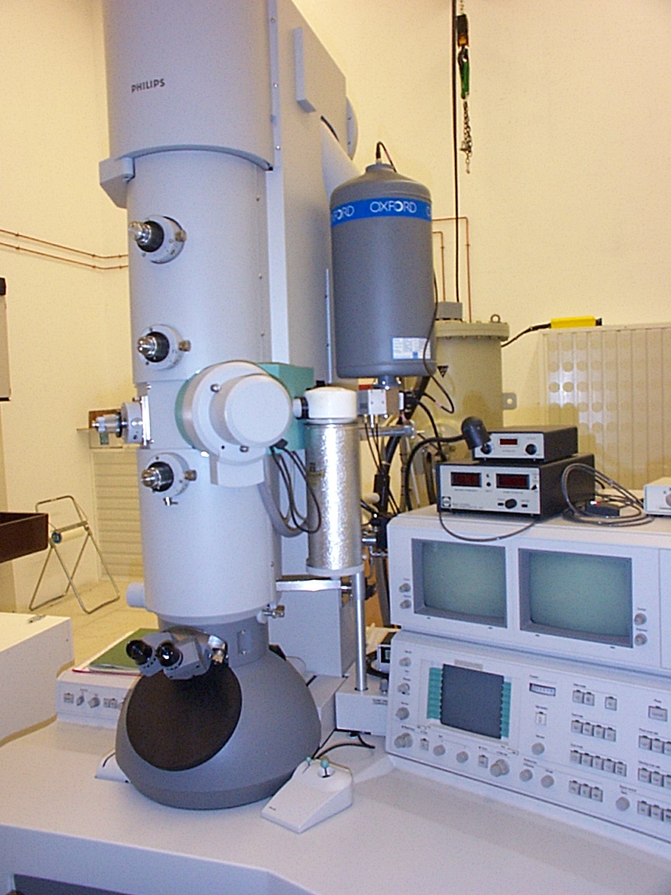
Typical TEM
EPFL: Philips CM300
300’000V

Slide 3
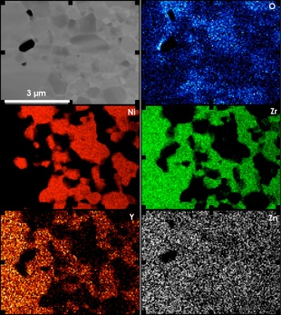
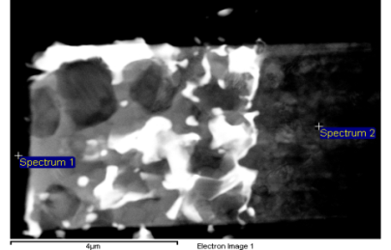
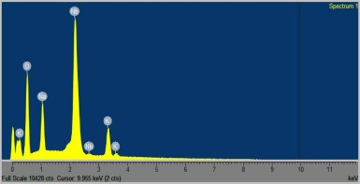
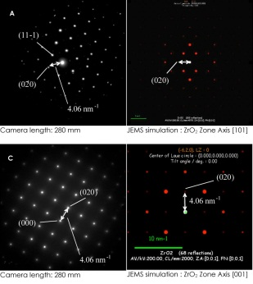
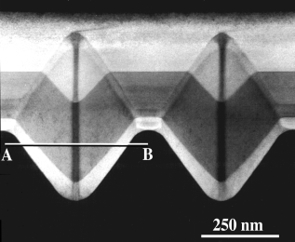
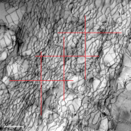
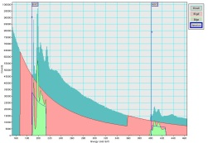
Signals from a thin sample
Backscattered electrons BSE
secondary electrons SE
Characteristic X-rays
Incident beam
visible light
Auger electrons
Specimen
1-100 nm
“absorbed” electrons
electron-hole pairs
direct beam
elastically scattered electrons
Bremsstrahlung
X-rays
inelastically scattered electrons

Slide 4
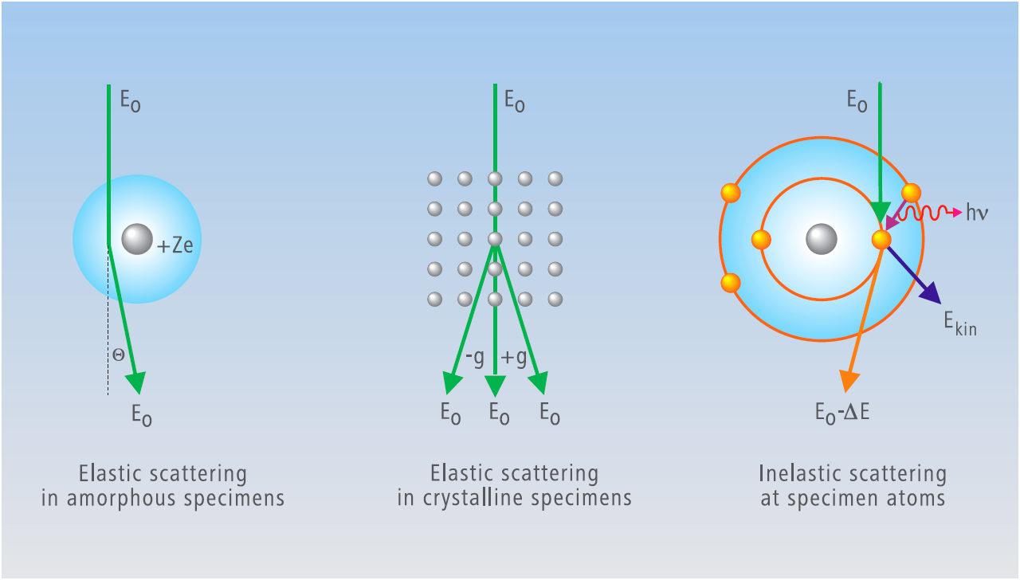
Interaction of high energetic electrons with matter
biological samples,
polymers
crystalline structure,
defect analysis,
high-resolution TEM
chemical analysis,
spectroscopy

Slide 5
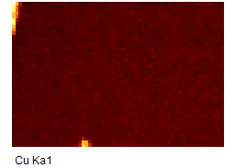
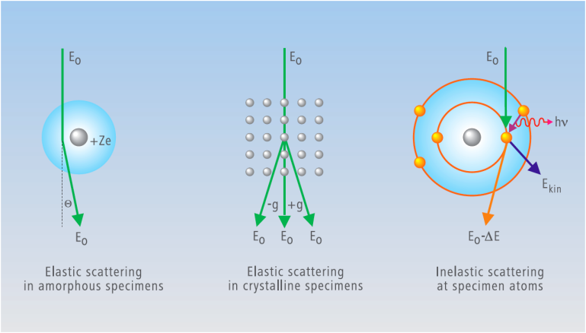
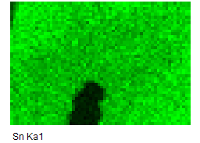
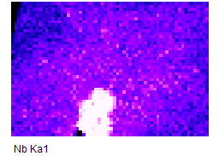
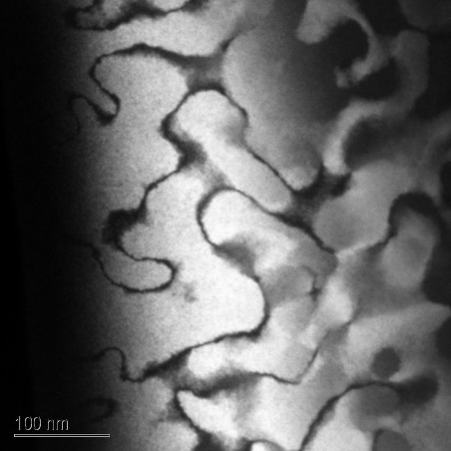
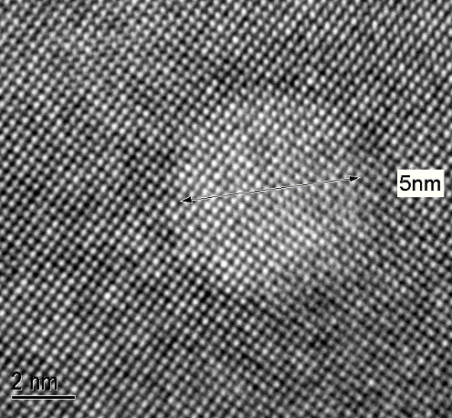
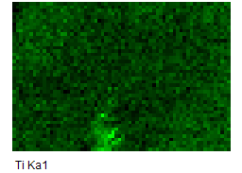
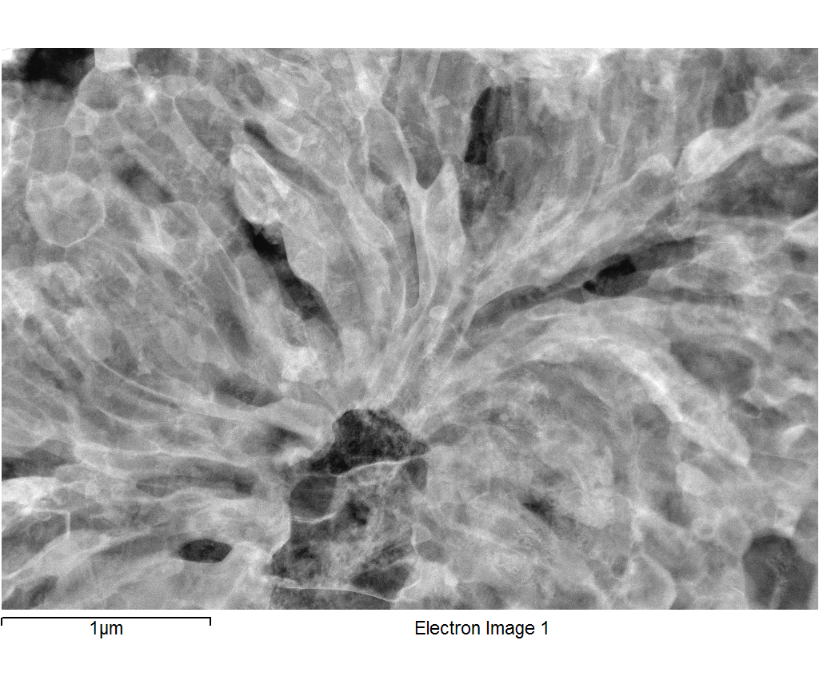
Interaction -> contrast
EDS, element maps
Thin section of mouse brain: mass contrast of stained membrane structures
(G.Knott)
STEM-DF
Dark field image of differently ordered domains:
Diffraction contrast
High-resolution image:
Image contrast due to interference between transmitted and diffracted beam
Element distribution maps
Of Nb3Sn superconductor

Slide 6

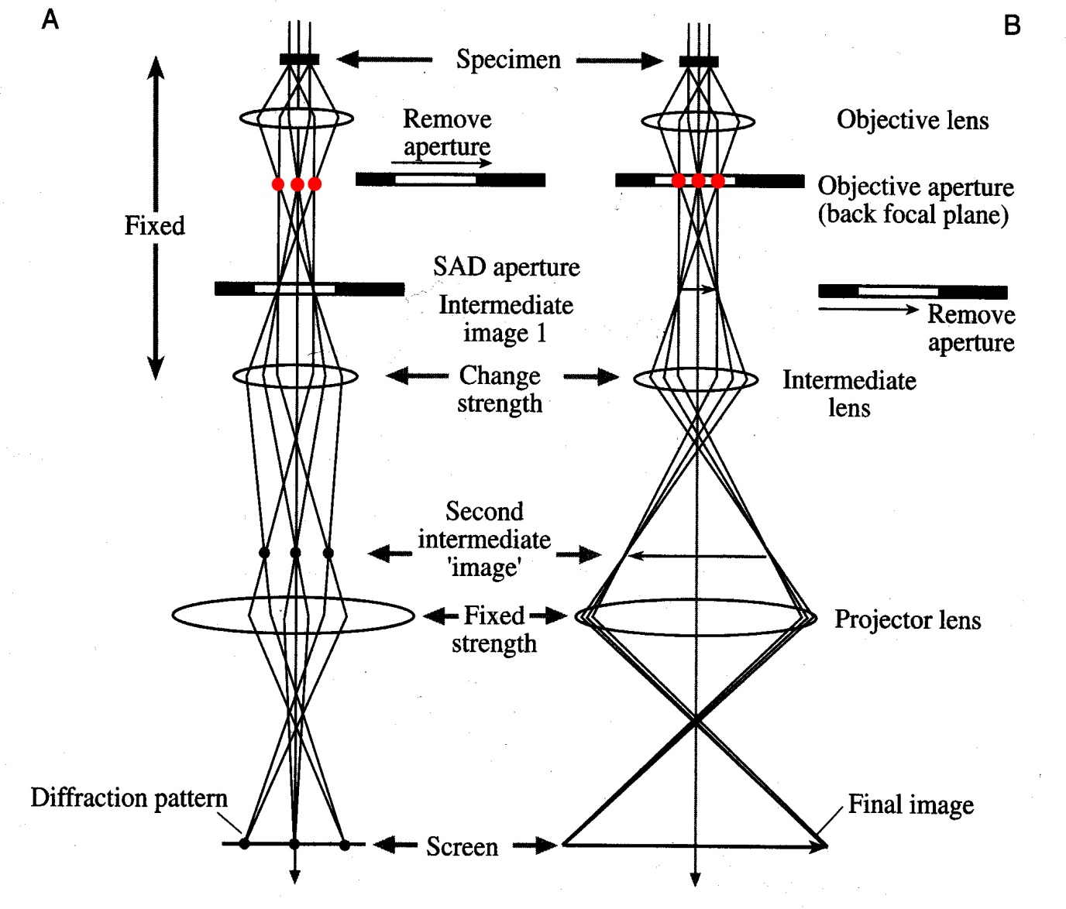
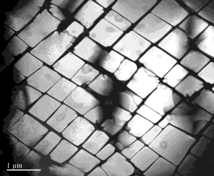
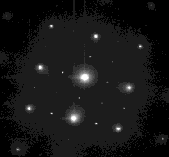
Two basic operation modes Diffraction <-> Image
Diffraction Mode
Image Mode

Slide 7
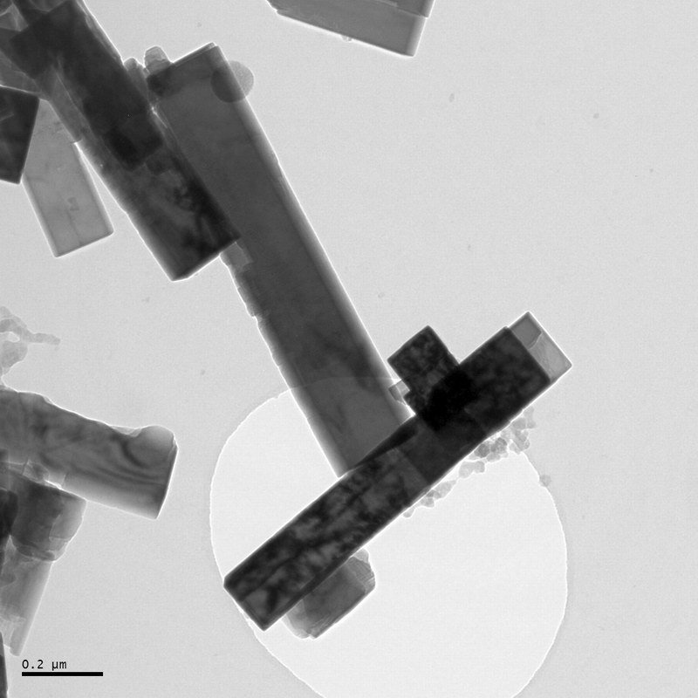
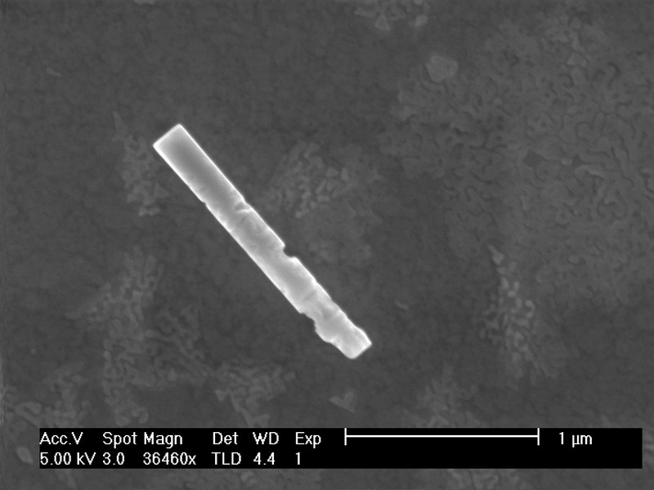
TEM
(K,Nb)TaO3
Nano-rods
holey Carbon film
SEM

Slide 8
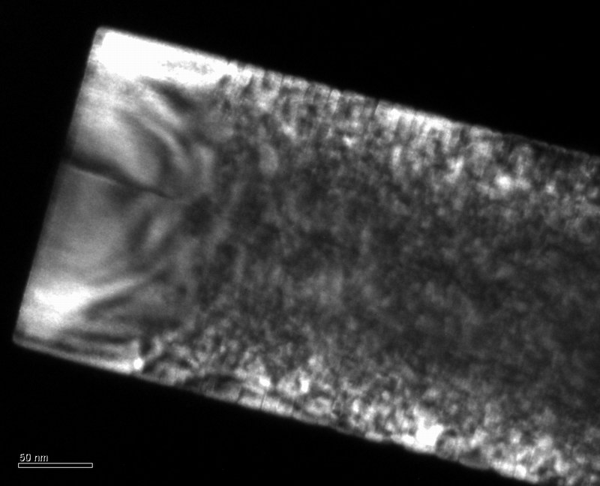
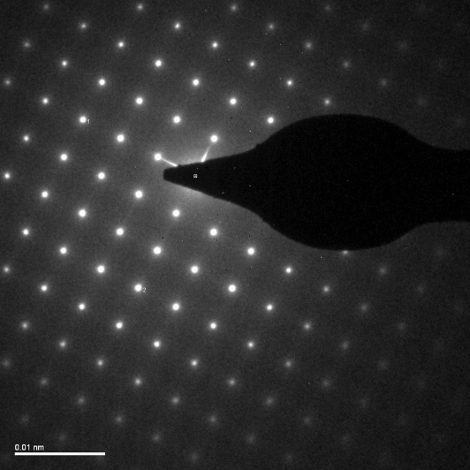
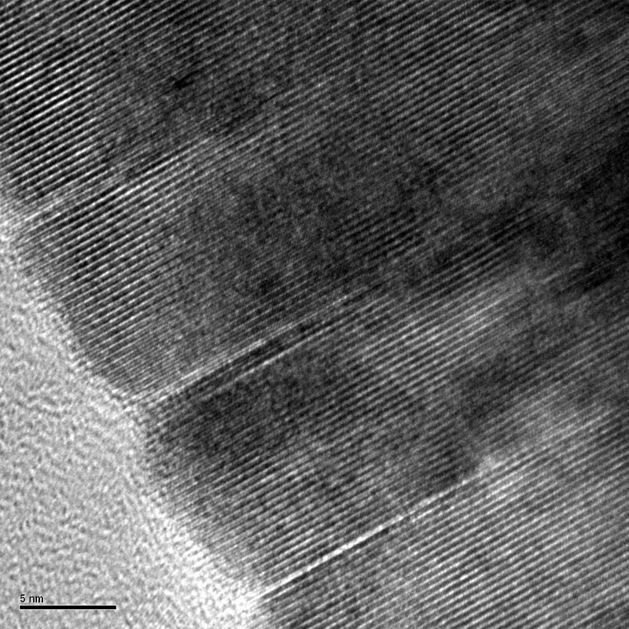
Shape, lattice parameters, defects, lattice planes
dark field image
Diffraction pattern
(K,Nb)O3
Nano-rods
High-resolution image
Bright field image

Slide 9

Diffraction theory
Introduction to electron diffraction
Elastic scattering theory
Basic crystallography & symmetry
Electron diffraction theory
Intensity in the electron diffraction pattern
Thanks to Dr. Duncan Alexander for slides

Slide 10
Why use electron diffraction?
Diffraction: constructive and destructive interference of waves
wavelength of fast moving electrons much smaller than spacing of atomic planes => diffraction from atomic planes (e.g. 200 kV e⁻, λ = 0.0025 nm)
electrons interact very strongly with matter => strong diffraction intensity (can take patterns in seconds, unlike X-ray diffraction)
spatially-localized information (≳ 200 nm for selected-area diffraction; 2 nm possible with convergent-beam electron diffraction)
close relationship to diffraction contrast in imaging
orientation information
immediate in the TEM!
( diffraction from only selected set of planes in one pattern - e.g. only 2D information)
diffraction from only selected set of planes in one pattern - e.g. only 2D information
( limited accuracy of measurement - e.g. 2-3%)
limited accuracy of measurement - e.g. 2-3%
( intensity of reflections difficult to interpret because of dynamical effects)
intensity of reflections difficult to interpret because of dynamical effects

Slide 11
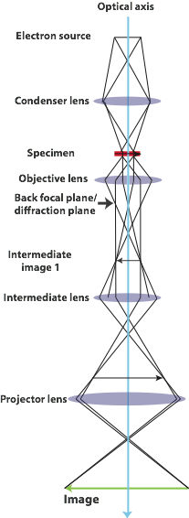
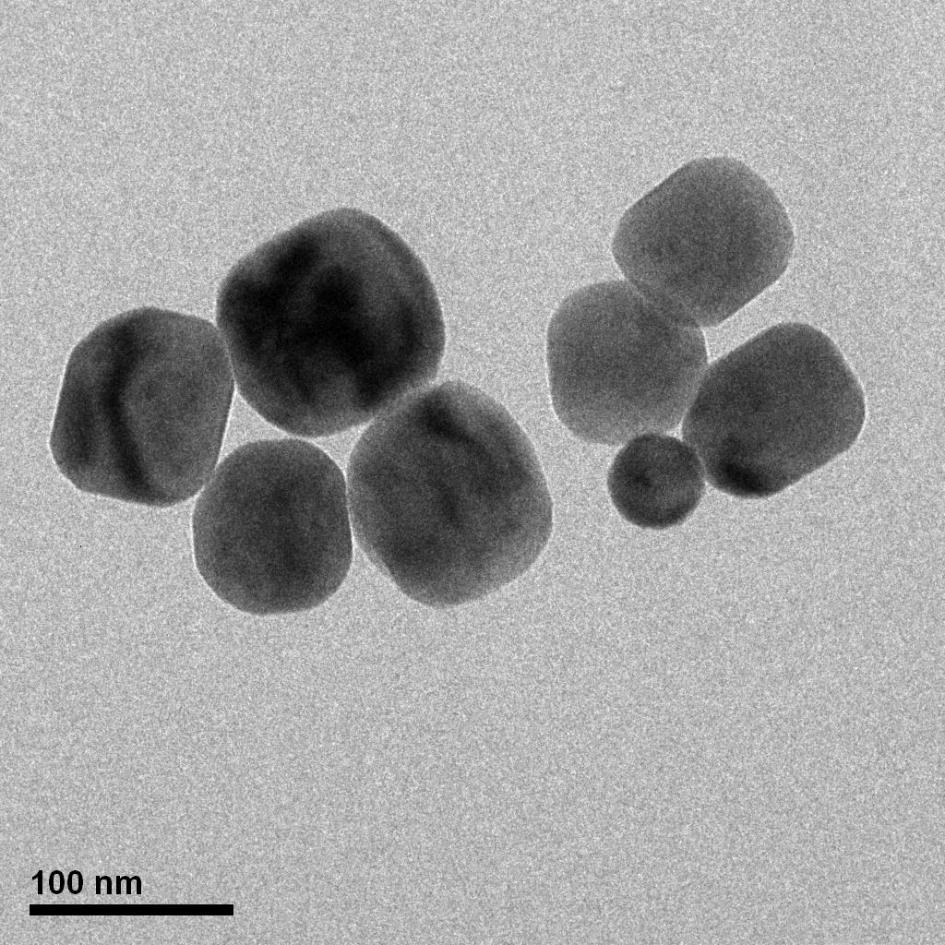
Image formation
BaTiO3 nanocrystals (Psaltis lab)

Slide 12
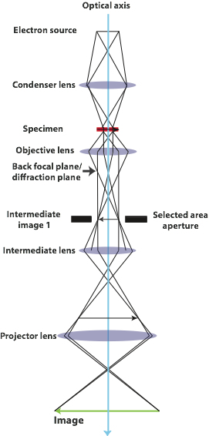
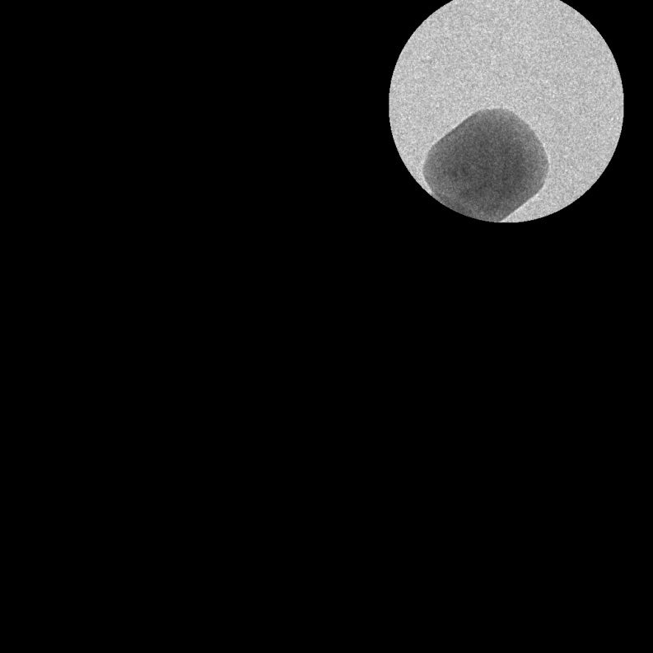
Area selection
BaTiO3 nanocrystals (Psaltis lab)
Insert selected area aperture to choose region of interest

Slide 13
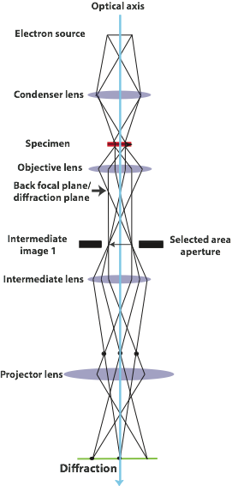
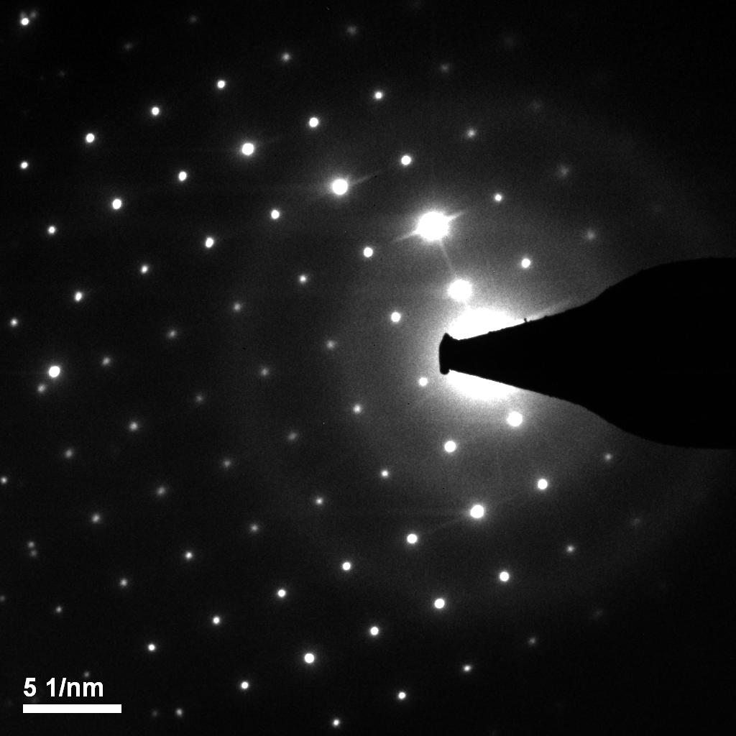
Take selected-area diffraction pattern
Press “D” for diffraction on microscope console - alter strength of intermediate lens and focus diffraction pattern on to screen
Find cubic BaTiO3 aligned on [0 0 1] zone axis

Slide 14
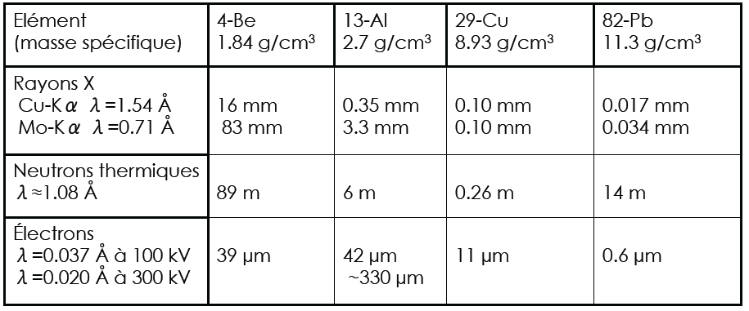
Scatter range of electrons, neutrons and X-rays
(99% of intensity lost)

Slide 15
electron, neutron X-ray scattering
wave | Wavelength λ | Source | Scattering at | Differentiation of | Sample size
X-rays | 0.07nm 0.15nm | X-ray tubes synchrotrons | Electron cloud | Lattice parameters Unit cell | 0.1mm
Electrons | 2pm @300keV | e guns (SEM/TEM) | Potential distribution (electrons & nucleus) | Lattice parameters, Orientations | 0.1um
Neutrons (1) | ~0.1nm | Nuclear reactors | Nuclear scattering (nucleus) | LP, isotopes | m
Neutrons (2) | “ | “ | Magnetic spin (outer electrons) | Oxidation states | m
Scattering power: n : X-ray : e = 1 : 10 : 10⁴

